Slide 1





BOMB FIGHTER
TEAM 7:
ZORA
SENBO YAN
SUSHRUTH
WEI

Slide 2
AGENDA
Project Objective
Game Overview
GUI
Class Diagram
Design Pattern
Thread
Use Cases
Sequence Diagram
OO Principles
5 C’S
Project Management Details
Lessons Learned

Slide 3
PROJECT OBJECTIVE
Understand and utilize OOADP concepts learnt in COEN 275 through a project implemented in JAVA.

Slide 4
GAME OVERVIEW
Bomb Fighter is a two-player strategy-oriented, action-adventure game.
Player has to defeat the opponent by collecting the maximum possible treasures.
The treasures are hidden from the view during the beginning on the game and the player has to place bombs to destroy the obstacle and collect the treasure.
The player can also win the game by bombing the opponent.
Each game has a set amount of time and it will stop when time is over, the player with more coins collected win the game.
Notes:
The original idea of this game comes from a combination of tank fighter and pacman games.

Slide 5
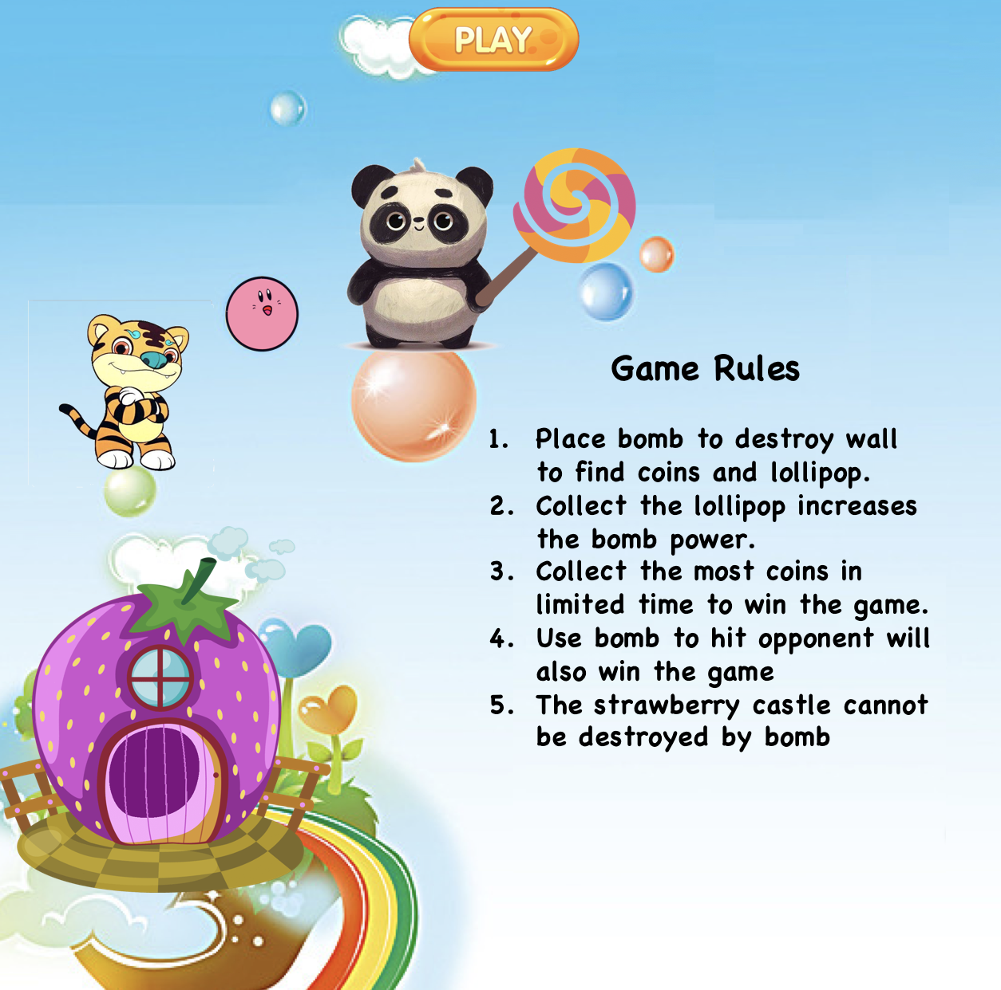
GUI – MENU PAGE
JButton – Start Button
Game Menu JPanel
JFrame

Slide 6
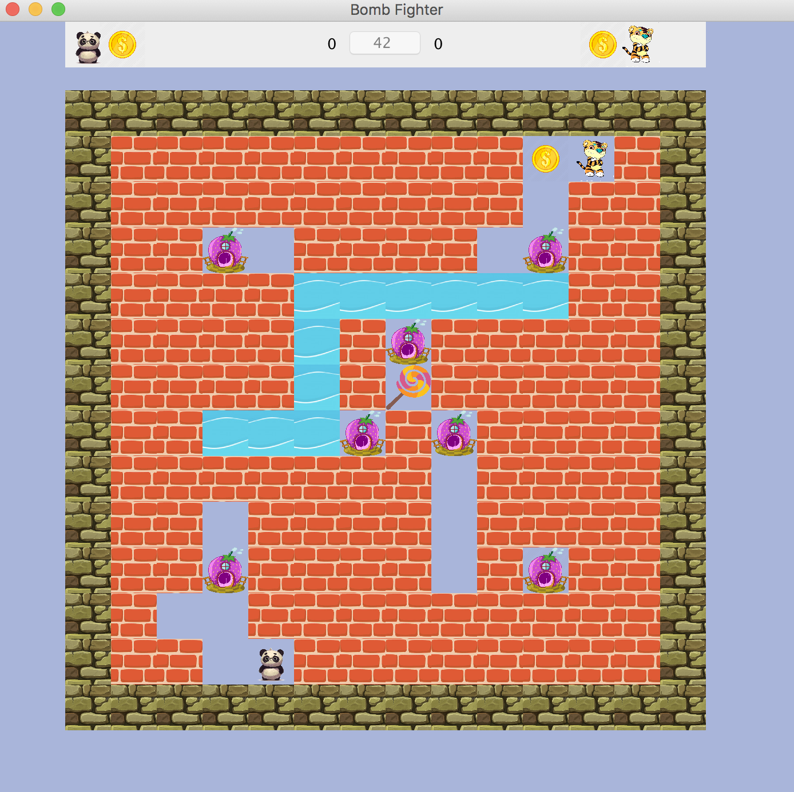
GUI – GAME PAGE
Scoreboard Panel
1 - Timer
2 - # Coins
JButton
Outer Wall Panel
JFrame
Gameboard Panel

Slide 7
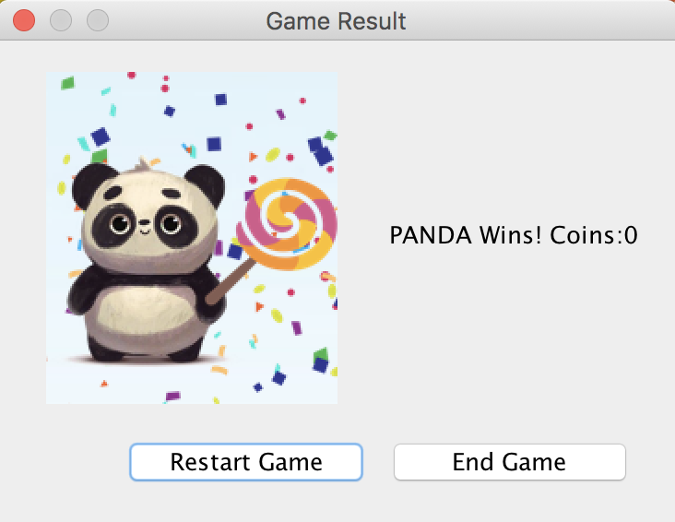
GUI – GAME END PAGE
Title
JOptionPane
Message
Icon
Options
Notes:
JOptionPane makes it easy to pop up a standard dialog box that prompts users for a value or informs them of something.

Slide 8
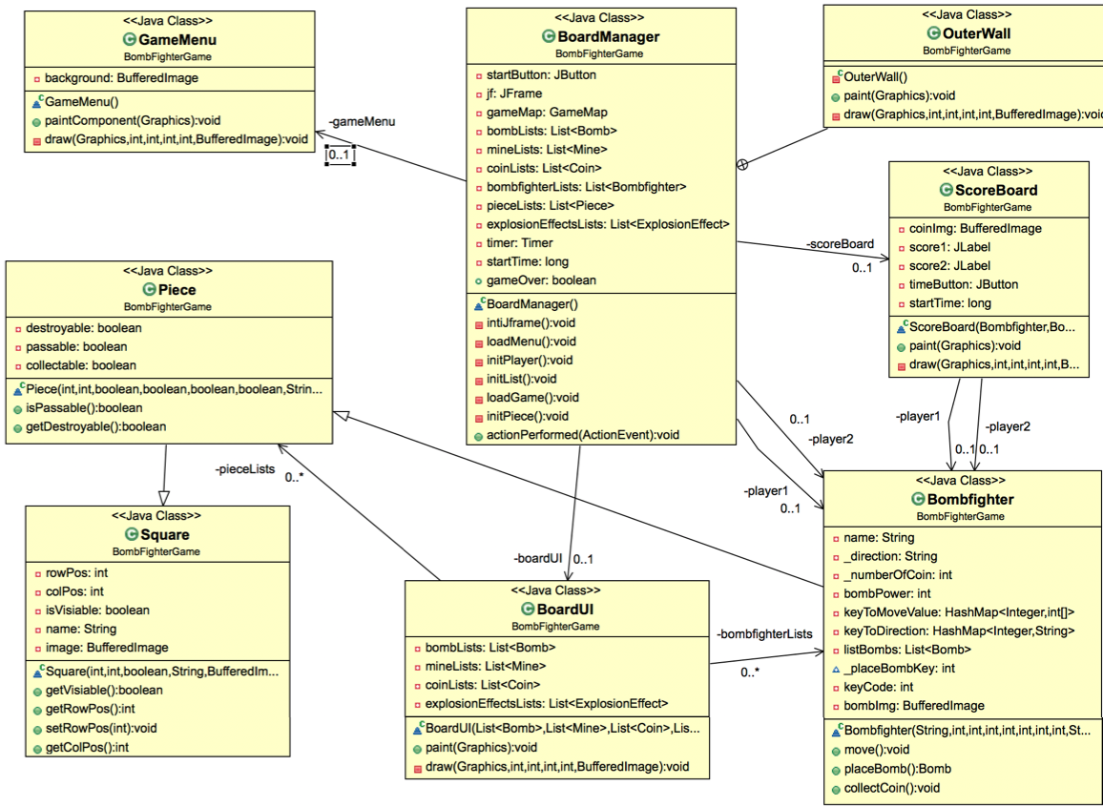
CLASS DIAGRAM
1
0..n
1
0..n

Slide 9
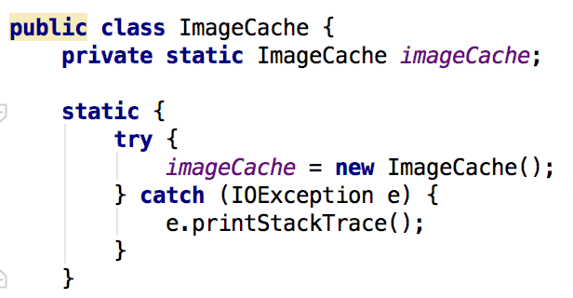
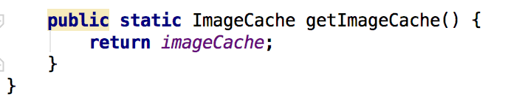
DESIGN PATTERN 1
Singleton
1.
Composite Design pattern
Create only 1 ImageCache instance to hold all images,
when other class need to use the image, it can directly
call the getImageCache to get the instance.

Slide 10
DESIGN PATTERN 2
Composite
BoardManager
GameMenu
BombFighter
ScoreBoard
GameMap
Bomb List
Composite Design pattern

Slide 11
THREAD
There are 2 Threads implemented in the project:
Thread 1 - The first thread is used on the LoadResources() method that basically loads all the resources(Images, Sound, UI-Setup etc.)
Thread 2 - The second thread, which is concerned with loading the game and its logic, is invoked in parallel.
REASONS FOR USING THREADS
Performance - Significant increase in performance and decrease in lag as all UI components and sounds are readily available when the game is loaded.

Slide 12
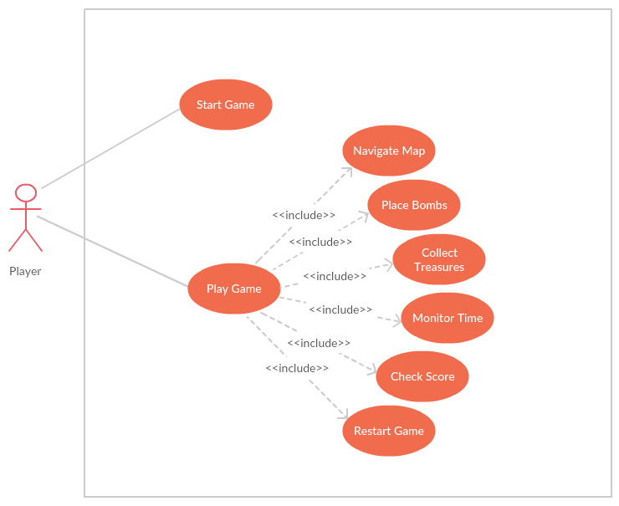
USE CASE DIAGRAM

Slide 13
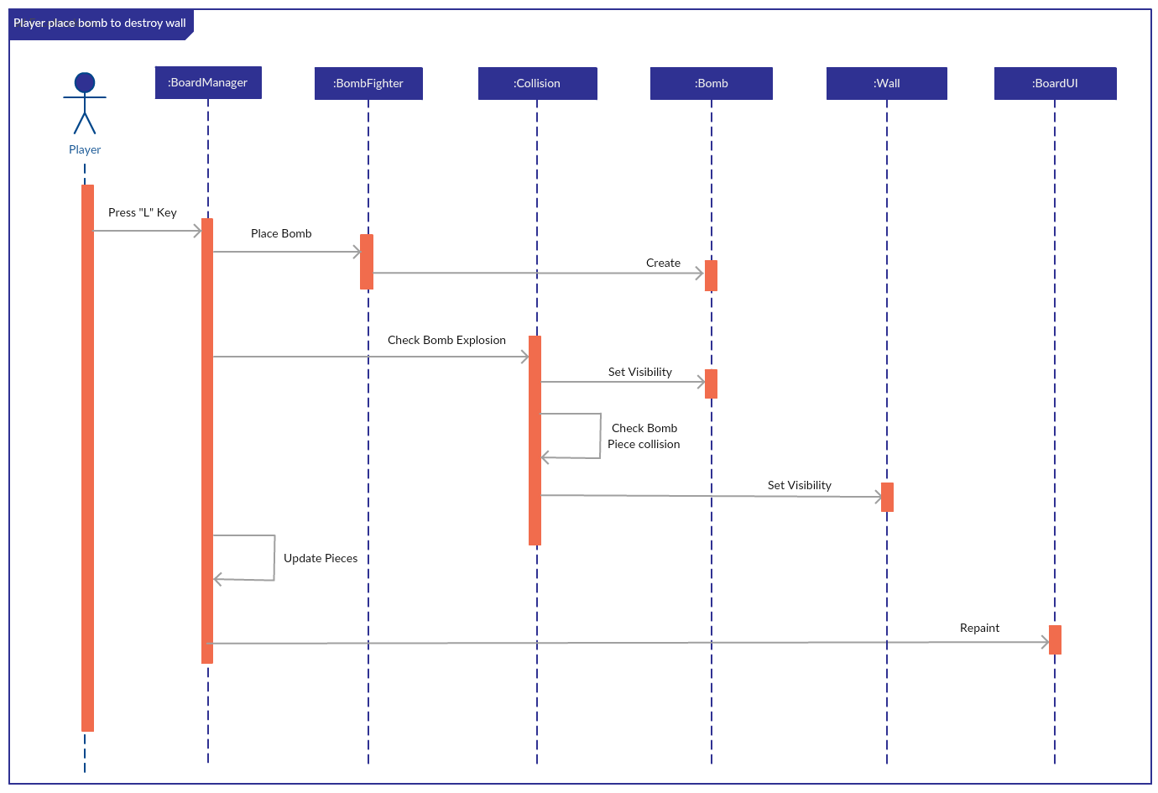
SEQUENCE DIAGRAM

Slide 14
OO PRINCIPLES
Encapsulation:
Critical information is kept safe from external interference through using private member variables and appropriate setters and getters.
Abstraction:
All things are Square
All blocks are Piece
Square
Bomb, Mine
Piece
All blocks (river, wall..)
Coin, lollipop

Slide 15
OO PRINCIPLES
Modularity - OOA:
Decomposed object of the game into:
BombFighter
Blocks
Rivers
Walls
Castle
- Bomb
Modularity - OODP:
Decomposed the implementation into:
UI
GameMenu
BoardUI
ScoreBoard
Logic
BoardManger
Collision
- Data / Cache
- LoadResource thread
Notes:
The primary tasks in object-oriented analysis (OOA) are:
Find the objects
Organize the objects
Describe how the objects interact
Define the behavior of the objects
Define the internals of the objects

Slide 16
5 Cs
Cohesion
BoardUI Class only deal with paint and layout, ScoreBoard Class display user score
Clarity
BombFigher class contains members and behaviors that represents its purpose, such as placeBomb(), collectCoin() reflect the actual behaviors
Completeness
Collision class support all operations that are related to collision, such as bombPiece() collision(), explode(), detectMine()
Consistency
All classes have consistent naming schemes. e.g, BombFighter refers to the player give a direct idea of what the behaviors are
Convenience
Employ resource cache class, make it convenient to call sound and image by getter function
Notes:
Cohesion (or coherence): all of its methods are related to a single abstraction
Clarity: clear to programmers, without allowing confusion or ambiguous interpretations
Completeness: support all important operations that are a part of the abstraction
Consistency
Operations in a class will be most clear if they are consistent with each other
This applies in naming conventions, behavior, how similar methods are set up with parameters and returns, etc
Convenience ( convenient to call)
Basically, this means ease of use for the intended user
Make sure you understand who your likely user is!
Could be a general application programmer (as with Java API packages)
Could be another subsystem of the system being designed
Perhaps all tasks are possible, but are they all easy? Or does the user have to jump through hoops to accomplish certain tasks?

Slide 17
PROJECT MANAGEMENT
Traceability:
Assign ID to functional requirements & non-functional requirements
UML diagrams
Code: we can trace the code in multiple way, such as use document, UML diagrams and IDE
Testing
White Box testing
Black Box testing
Notes:
5. Discuss how you managed traceability between your source code and your analysis
6. Discuss how you tested your program

Slide 18
LESSONS LEARNED
Zora
Law of Demeter
Separating concerns really helps!
Senbo
Develop UML models for software design, and built multilayered OO applications using Java
Wei
Deep understanding on OOADP concepts from a real project; be familiar with the flow of software development.
Sushruth
Separation of Concerns-
Maintainable and Extensible Codebase
Readable Code(No big ball of mud)
MVC Structure
Notes:
Lessons Learned as it relates to our class discussions for OOA, D and P
Separation of concerns - ideal for building maintainable code that is readable to all members

Slide 19
DEMO

Slide 20
FUTURE SCOPE
Dynamically generate Maps
Different Levels
Load/Save
UI Enhancement
Improved Animations

Slide 21
Question?

